Slide 1
Cryptocurrency Visualisations
Group 6
Team Members:
Mohammed Hamdouna
Myrna Deseo
Rasika Senadheera

Slide 2



Cryptocurrency
What is cryptocurrency
Cryptocurrency (also known as crypto) is a digital currency designed to work as a medium of exchange. It uses cryptography to secure and verify transactions, as well as to control the creation of new units of a particular digital currency.
Data Source:
https://www.kaggle.com/datasets/odins0n/top-50-cryptocurrency-historical-prices
Visualise the daily price trend from each currency.
Determine which currency is stronger or weaker based on a weekly, monthly and annual basis.
Use the visualized data to determine if an investor would have gained profit between two time points.
Notes:
What is cryptocurrency
Data source is from kaggle

Slide 3



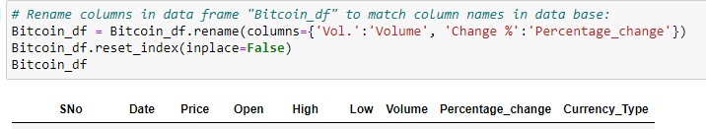
Extract and clean data
Using Pandas:
Loaded 3 different csv files and stored in a DataFrame
Added a new column to each DataFrame to create a common header
Cleaned data by dropping NAs
Renamed columns for all Dataframes

Slide 4







Extract and clean data
Using Pandas:
Get min date for all sets
Get max date for all sets
Removed all rows earlier than the common date
The three DataFrames were combined by concatenating; that is, combined all rows
Saved as a new csv file
Common date for all files
max date was the same for all files
Notes:
Determine
Oldest date – remove all rows for earlier date we picked so we are comparing the currencies from same time frame
Latest date
Common date picked for all three coins – 2017 – 04 -14
All DFs were combined by concatenating

Slide 5
Folder Structure
Project 3 Folder:
data_etl.ipynb
app.py
Flask to launch index.html
templates
(index.html)
static
Data
(csv files)
js
(app.js)
Notes:
This is how the files are structured within the project folder
The index.html file must be inside the templates folder

Slide 6
Flask API: app.py
# Import and setup
from flask import Flask, render_template, redirect
# Create instance of flask app
app = Flask(__name__)
# Create route that renders index.html template
@app.route("/")
def index():
return render_template("index.html")
if __name__ == "__main__":
app.run(debug=True)
Notes:
We used Flask API to launch the website
Code for app.py to import flask and render template, and redirect to the index.html

Slide 7
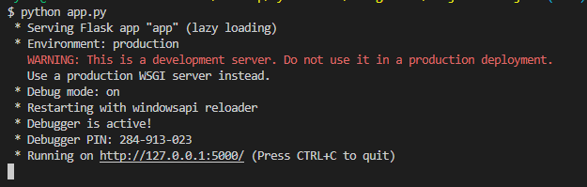
Flask API: app.py
Notes:
Output of app.py

Slide 8
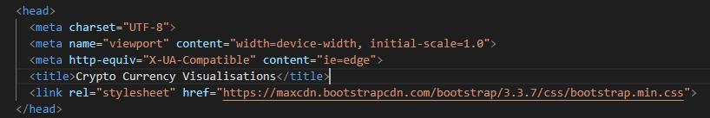
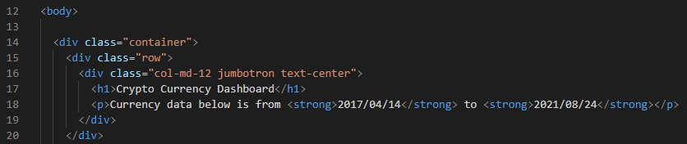
Create index.html file
Create Dashboard: Bootstrap
Notes:
Use Bootstrap for the front-end framework of the website
Use Jumbotron for the page header

Slide 9
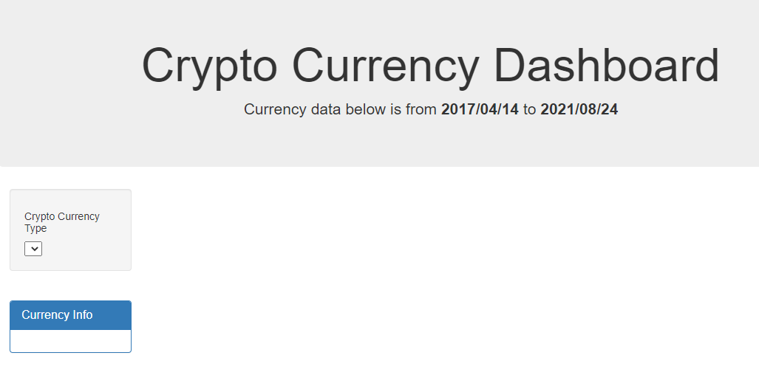
Dashboard
Notes:
This is how the dashboard looks like
The data were “cleaned” to get the same range of date for the 3 crypto currencies (2017 to 2021)

Slide 10

Create index.html file
Create scripts:
d3.js
Plotly
Javascript file
Notes:
The scripts were then added to generate the website content.

Slide 11
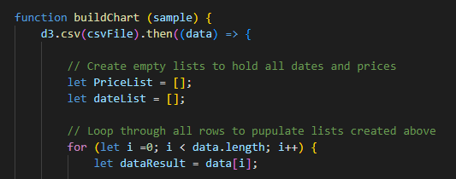
Javascript file
Do a console log to call the JS file:
Build charts and do a for loop

Slide 12
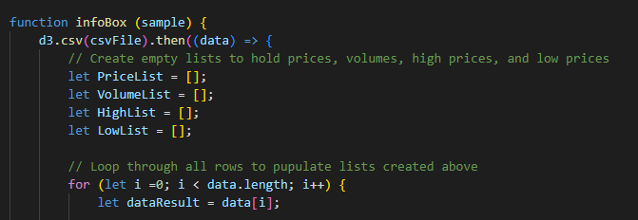
Javascript file
Create info box and do a for loop:

Slide 13
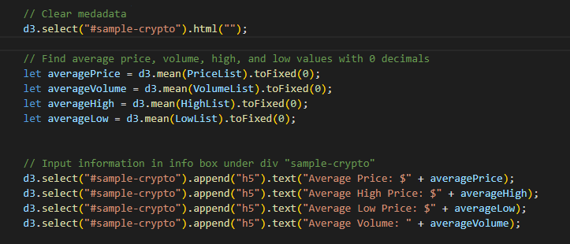
Javascript file
Getting average values and appending Info Box

Slide 14
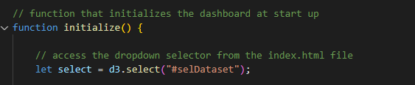
Javascript file
Initialise the dashboard

Slide 15
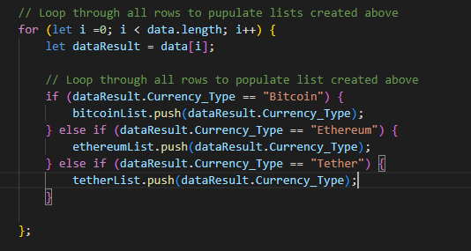
Javascript file
Loop through data

Slide 16
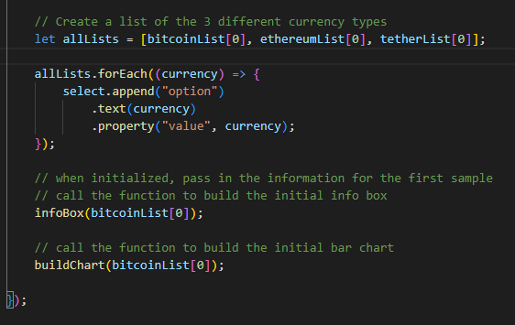
Javascript file
Reflecting information on html page

Slide 17
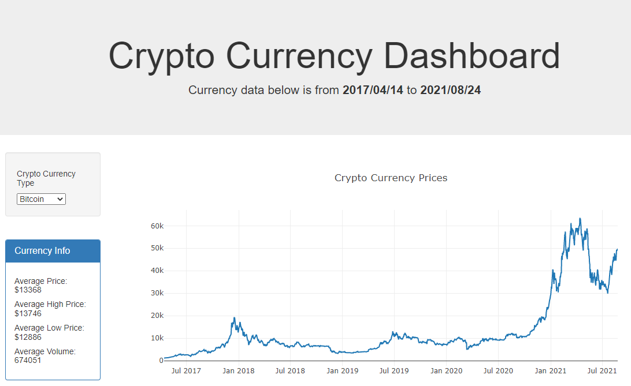
http://127.0.0.1:5000 (Do a demo of the website)
Notes:
Change screen to live server for demo, changing currency type and zoom in on dates.

Slide 18
Thank you for your attention.
QUESTIONS?

